Slide 1

Behaviour at the Grove
Thursday 22ND AUGUST 2024

Slide 2
ASENSE OF BELONGING
Researchers have found that students who feel confident that they belong in their school and class, and are valued by their teachers and peers, have fewer behaviour problems (Romero, 2018) They also learn better; it has been argued that when pupils are unsure about whether belong, they are constantly on the look-out for cues in the environment that signal whether or not they fit in. This hypervigilance uses up cognitive resources that are essential for learning.

Slide 3
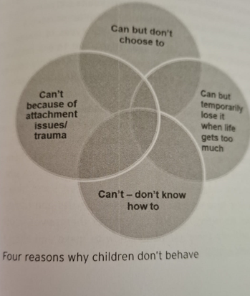
Four reasons why children don’t behave

Slide 4
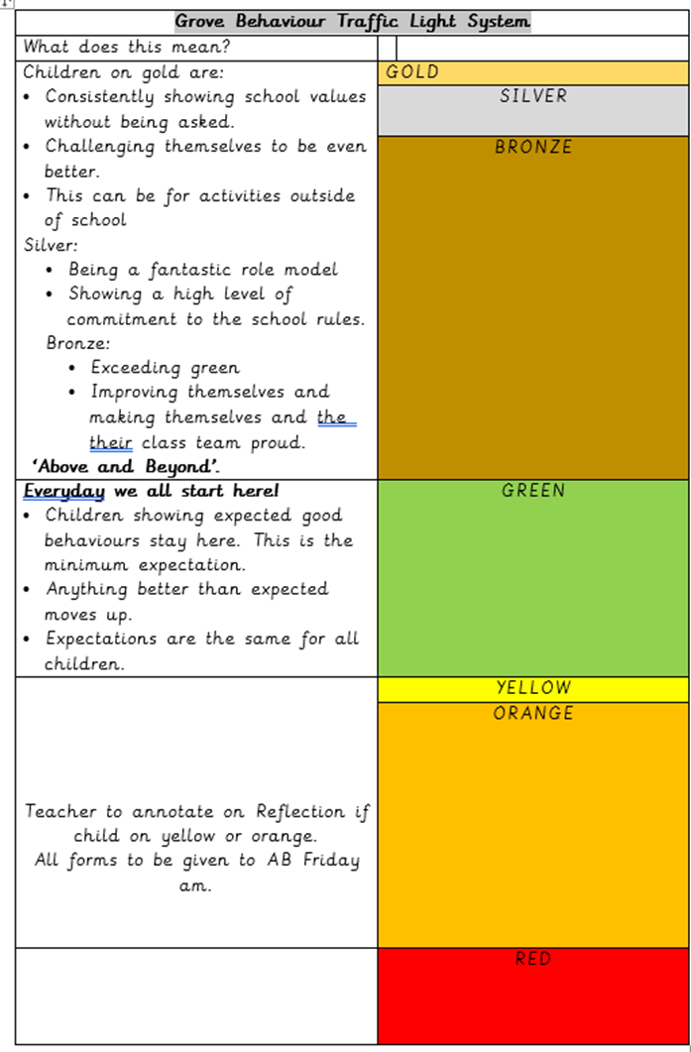

Slide 5
Traffic lights
Green – child is doing what they should be doing
Yellow- child loses 5 minutes of their breaktime. Teachers will need to do this in their classrooms.
Amber-Buddy class
Red-SLT

Slide 6
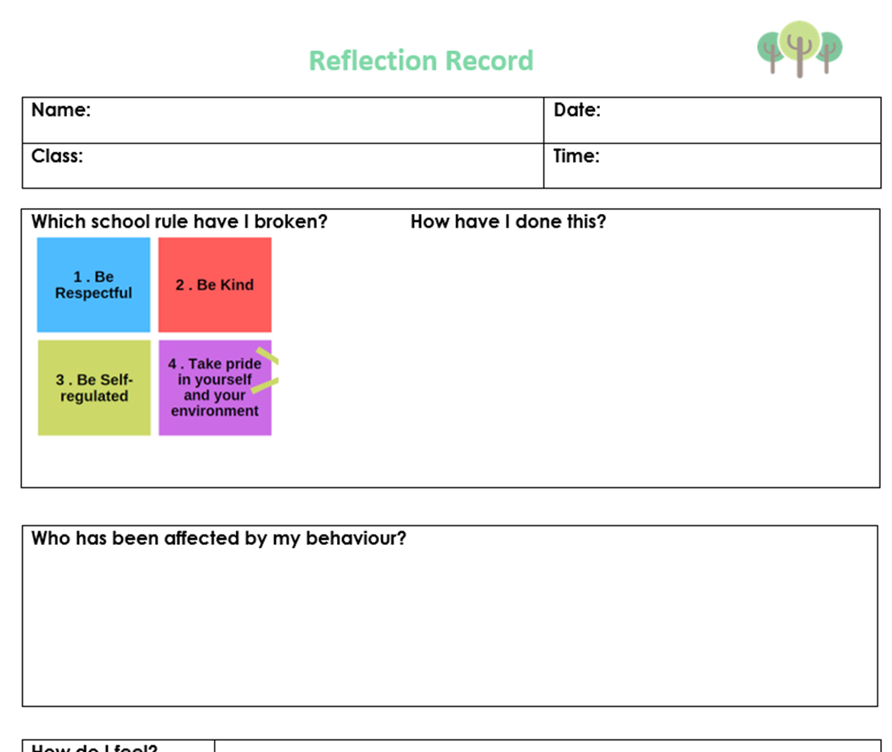
Reflection forms

Slide 7
Reminders regarding recording of behaviour incidents
Please continue to use behaviour forms to record all incidents of behaviour. Please also attach your notes that you make to your behaviour forms. Please include as much information as possible and ensure that we use are using positive language. Remember parents can ask to see these!
Make sure you include your investigation notes with all behaviour forms. Include what happened and not an opinion. e.g stating that the child was aggressive isn’t proactive. What did this look like? How was the child demonstrating this behaviour? What were they doing?
We will continue to use my concern for safeguarding incidents. This makes it easier to distinguish between behaviour and safeguarding and will help us when Ofsted ask us questions.
When investigating incidents. LSA’S should do this unless SLT state they will. This helps to avoid Chinese whispers.

Slide 8

School values

Slide 9
Please can behaviour forms be left in the tray in my room at the end of the day.
Behaviour forms are not needed for yellows such as running in corridor. To be used only for amber and red.
Parents informed by teachers about ambers.
SLT will inform parents about red behaviour.
There will be weekly updates on patterns in SLT.
For all children who have a behaviour plan, teachers will need to upload these to teams so that they are easily accessible. Please upload these on teams under behaviour and then behaviour plans. Last year's teachers should make sure they are updated for the new teacher.
Staff should only leave the classroom to find and additional adult if children are on red.
During break times, remain proactive and spread out. It is important that we talk to and engage with the children.

Slide 10
Reflection room reminders
Please continue to fill out the first part of the reflection form so that we know why the child has come into us.
Please explain clearly to children which school rule they have broken and how. This helps the child to understand and process why they are in the reflection room.
There will be no reflection time for homework not being completed. This needs to be discussed initially between the class teacher and parents/carers.
Please do not leave children in the reflection room or standing outside in the corridor if an adult is not present.
When children are being in repeatedly for the same thing, we need to ask why.
Behaviour boosts and conformity habits are vital.

Slide 11
Recording on my concern
Please make sure you record accurately and precisely on my concern, being mindful of the language you use e.g if you record ‘spoke to mum’, how did you speak to mum? Was it face to face? Via dojo? On the phone?
When it says action taken, please do not write things like, ‘was told to put on my concern’ please write informatively who you spoke with, what did the child say?
Try and write as much detail as possible in the concern box. This helps when building evidence.
If a child continues to appear unclean and unkept, keep recording it. As time consuming as it is, this is vital and often aids the case when children are under an active social worker.

Slide 12
Things to remember….
Some of our children will not have enjoyed the summer holidays so please try to refrain from asking where they went on holiday, some won't have left home.
The cost of living crisis is pushing families into poverty. Please bear this in mind when children come into school next week as it could be a reason why we are seeing behaviour. We are always here to help with this. We have charities who have helped families with their energy bills. Food bags are available, free breakfast club, uniform support and Madmac to help with finances and debt management. We will help in every way possible.
Please make sure you are outside before the bell at the end of break and lunch. During the lining up, we often see behaviour incidents. Please keep those children away from each other who you know don’t make the right choices in each other's company.

Slide 13
Consistencies that help improve behaviour.
Keep allocating 2/3 dojos a day
After a weekend, if you notice a child is struggling in lessons, find out why. It could be that the child hasn’t had any breakfast or an incident happened over the weekend.
Be aware on Friday's children are tired and become less enthusiastic about their learning.
Remember that for some children, a weekend at home isn’t always positive, school is their safe place.
Be consistent with the new behaviour policy no matter the time of day or day of the week.
Staff need to always be modelling behaviours and self-regulation, even after school as we have clubs on.
Please make sure when talking, you do this in the staff room away from the corridors.
Keep referring back to the rules, routines and scripts document.
Make sure that you are out on time in the morning for your meet and greet children.
Continue to use positive language around children and remain mindful to not talk about the children in front of them. ‘Banter’ and sarcasm have a time and place.

Slide 14
Journey to outstanding
Consistency is key, we must always follow the behaviour policy.
Following on from my NPQ and the research around behaviour culture, teachers should imagine that there is a heat map of their movement around the classroom. Behaviour will be better when the teacher is moving around the classroom and not standing in the same spot. This helps to keep the child engaged.
Continue to communicate with parents and report back on any behaviour. Try and do this verbally where possible. If you recognise that a child is struggling or starting to display behaviour, speak with parent/carers and work together.
Pupil voice on behaviour is vital. Pupils should be able to clarify what good behaviour looks like and demonstrate this. Pupils should be able to speak about how they feel safe e.g ‘we had to vacate the classroom so that we are safe’. Please remind them of this.
Attendance and behaviour are linked. We need to support children with their attendance and improve our attendance overall as a school. If you notice a decline in a child's attendance in your class, please come and speak with us so that we can work together to tackle this. We do have fortnightly attendance meetings to tackle this.

